Slide 1
THE YUMMY APP
BY:
Tiara McMillan, Trevor Taylor, Chris Williams

Slide 2
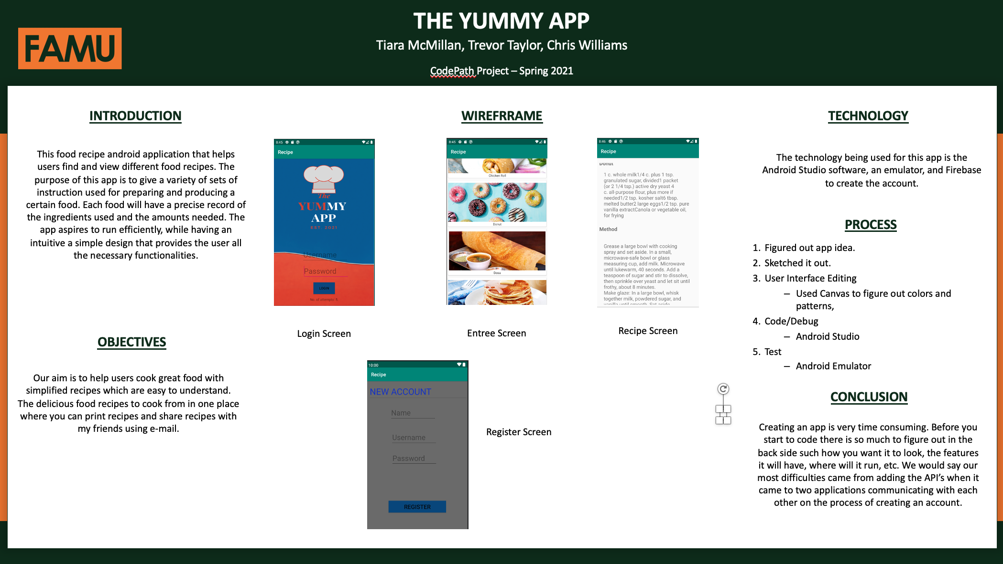
THE POSTER:

Slide 3
INTRODUCTION
This food recipe android application that helps users find and view different food recipes. The purpose of this app is to give a variety of sets of instruction used for preparing and producing a certain food. Each food will have a precise record of the ingredients used and the amounts needed. The app aspires to run efficiently, while having an intuitive a simple design that provides the user all the necessary functionalities.

Slide 4
OBJECTIVE:
Our aim is to help users cook great food with simplified recipes which are easy to understand. The delicious food recipes to cook from in one place where you can print recipes and share recipes with my friends using e-mail.

Slide 5
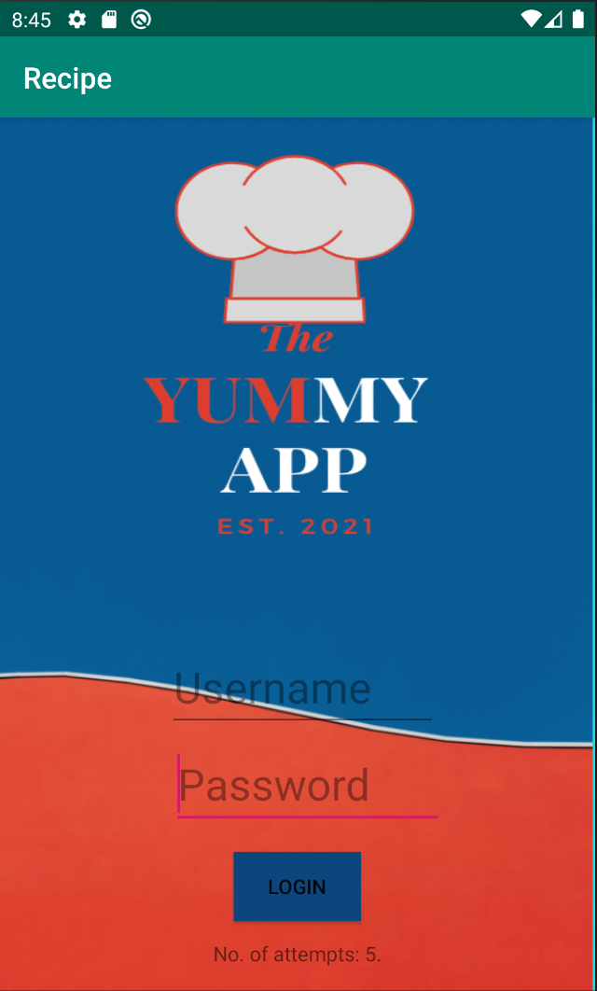
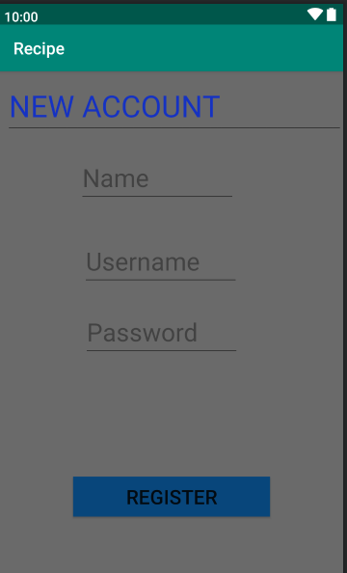
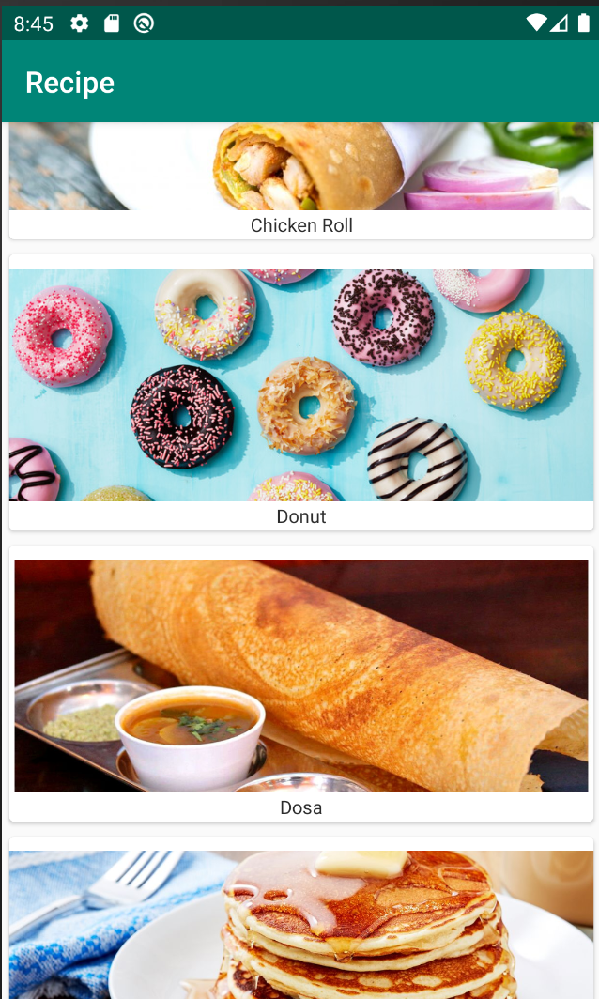
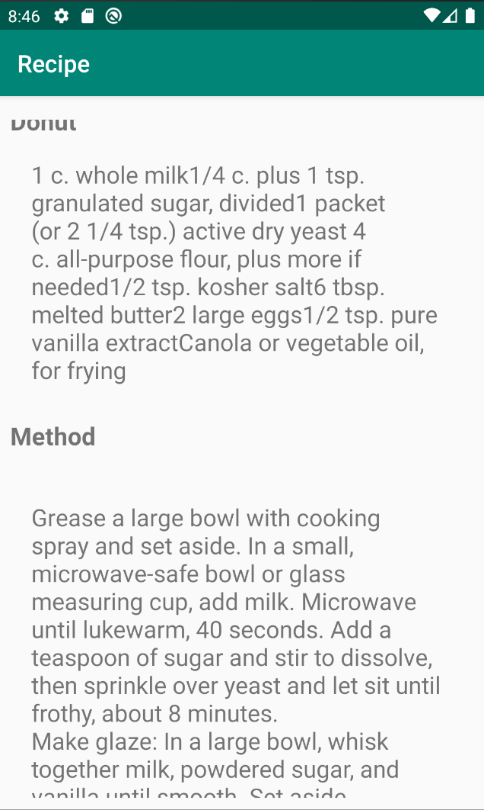
Wireframes:
Login Screen
Register Screen
Entree Screen
Recipe Screen

Slide 6
Video demo:
In this video, you can see us login on our account at the Login Screen. Then we get to the Entrée Screen which we choose an Entrée then after we choose one, we get to the Recipe Screen to show us how we will be making the entrée. If we don’t have an account, we go through the Login Screen again then click on Register Here where you will be led to the Register Screen then you will be creating an account then it will lead you to the Entrée Screen.

Slide 7


TECHNOLOGY
The technology being used for this app is the Android Studio software, an emulator, and Firebase to create the account.

Slide 8
Process:
1.) Figured Out App Idea.
2.) Sketched It Out.
3.) User Interface Editing
Used Canvas to figure out colors and patterns,
4.) Code/Debug
Android Studio
5.) Test
Android Emulator

Slide 9
conclusion
Creating an app is very time consuming. Before you start to code there is so much to figure out in the back side such how you want it to look, the features it will have, where will it run, etc. We would say our most difficulties came from adding the API’s when it came to two applications communicating with each other on the process of creating an account.

